Slide 1
Geogg124 The Terrestrial Carbon Cycle
P. Lewis
Professor of Remote Sensing
UCL Geography
& NERC NCEO

Slide 2
Aims of lecture
In this lecture, we will:
consider the importance of understanding the science of climate change
look at basic principles of energy transfer in the earth system
examine greenhouse gases and their sources
look in detail at the terrestrial carbon cycle
provide an overview of relevant biogeochemical processes
look in some detail at photosynthesis and factors that limit this

Slide 3
Terrestrial Climate and Climate Change
“(C)limate change is a defining issue of our generation. Our responses to the challenges of climate change - accurate prediction, equitable adaptation, and efficient mitigation - will influence the quality of life for ... the world, for generations to come.” (NASA, 2010).

Slide 4
From the IPCC AR4 (synthesis report):
Observed changes in climate and their effects
Warming of the climate system is unequivocal, as is now evident from observations of increases in global average air and ocean temperatures, widespread melting of snow and ice and rising global average sea level
Observational evidence from all continents and most oceans shows that many natural systems are being affected by regional climate changes, particularly temperature increases.
There is medium confidence that other effects of regional climate change on natural and human environments are emerging, although many are difficult to discern due to adaptation and non-climatic drivers

Slide 5
From the IPCC AR4 (synthesis report):
Causes of change
Global GHG emissions due to human activities have grown since pre-industrial times, with an increase of 70% between 1970 and 2004.
Global atmospheric concentrations of CO2, methane (CH4) and nitrous oxide (N2O) have increased markedly as a result of human activities since 1750 and now far exceed pre-industrial values determined from ice cores spanning many thousands of years.
Most of the observed increase in global average temperatures since the mid-20th century is very likely due to the observed increase in anthropogenic GHG concentrations. It is likely that there has been significant anthropogenic warming over the past 50 years averaged over each continent (except Antarctica).
Advances since the TAR show that discernible human influences extend beyond average temperature to other aspects of climate.
Anthropogenic warming over the last three decades has likely had a discernible influence at the global scale on observed changes in many physical and biological systems.

Slide 6
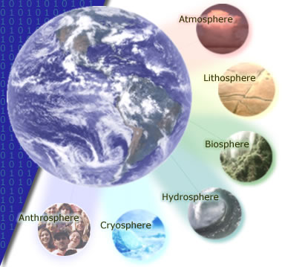
The 'spheres' of influence on the climate system

Slide 7
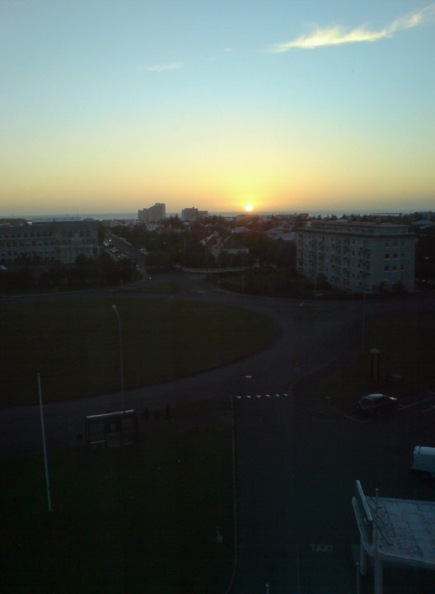
Energy transfer: basics
Driven by solar radiation

Slide 8
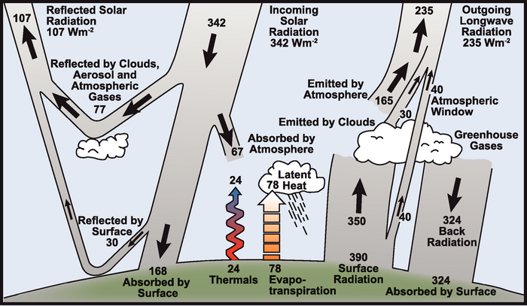
Earth’s climate is driven by (shortwave) solar radiation
Notes:
Around 31% of this incoming radiation is reflected by clouds, aerosols and gases in the atmosphere and by the land surface. The remaining 69% is absorbed, with almost 50% of the incoming radiation being absorbed at the Earth surface.
The shortwave radiation absorbed at the surface is, in the long term, transferred back to the atmosphere, so that around 69% of the incoming energy flux is re-rediated to space as longwave radiation.
The energy absorbed at the surface drives thermals (atmospheric convection) and evapo-transpiration (latent heat transfer: change of state of water). The rest of the energy balance is maintained by thermal (longwave) radiation emitted by the surface, the atmosphere and clouds.

Slide 9
large proportion of longwave radiation emitted by the surface is re-radiated back to the surface (and absorbed by the surface) by clouds and so-called greenhouse gases
‘trapping’ of longwave radiation naturally maintains temperature on Earth – the ‘natural greenhouse effect’.
Without this, temperature much less that it presently is (-19C)

Slide 10
Exercise
‘develop a simple ‘zero-dimensional’ model of the climate system
Use this model to show what the sensitivity of the temperature is to albedo and the incoming solar radiation.
what factors would cause variations in these terms?
Assuming the actual average surface temperature is around 14 C, modify the code above to return the effective emissivity of the Earth.
We assumed above that the effective (broadband) shortwave albedo was 0.31, so the effective (broadband) shortwave absorptance is 1-0.31=0.69. The effective (broadband) longwave absorptance is equal to the effective (broadband) longwave emissivity through Kirchoff’s law (of thermal radiation), assuming thermal equilibrium. What then is the effective (broadband) longwave albedo?
Why do we use the words effective and broadband above?
What impact would increasing the concentrations of greenhouse gases have on the effective (broadband) longwave albedo?
Notes:
Skip over this

Slide 11
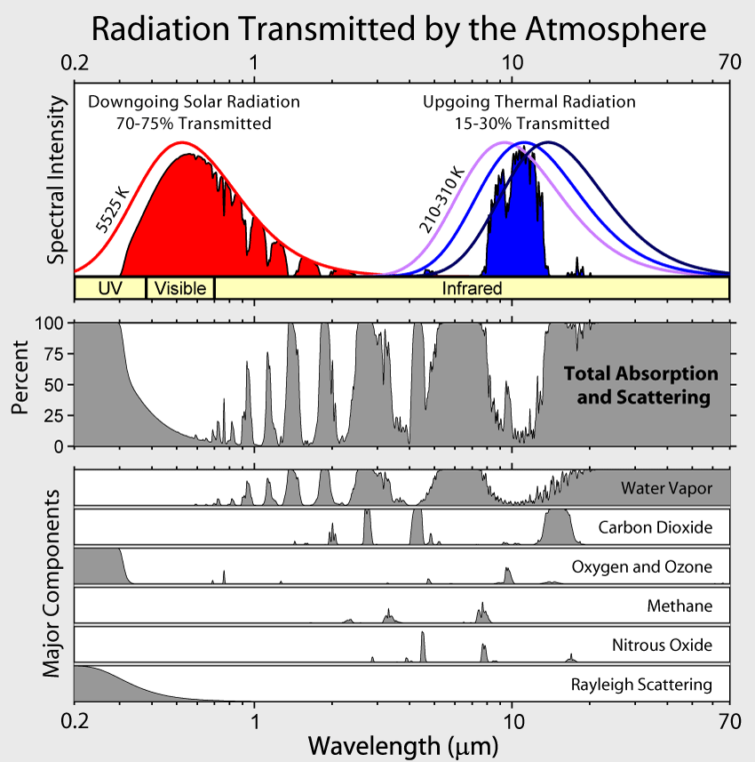
Atmospheric absorption
Notes:
major absorbing (and scattering, other than aerosols) constituents of the atmosphere for shortwave and longwave wavelengths and their impact on atmospheric transmission. … discuss + mention clouds & aerosols

Slide 12
Radiative Forcing
measure of the radiative impact of components of the climate system
“a measure of the influence a factor has in altering the balance of incoming and outgoing energy in the Earth-atmosphere system and is an index of the importance of the factor as a potential climate change mechanism. ... radiative forcing values are for changes relative to preindustrial conditions defined at 1750 and are expressed in watts per square meter (W/m^2).” IPCC AR4
AR4: most likely value of (net positive) radiative forcing due to anthrogenic sources is about an order of magnitude larger than the estimated radiative forcing from changes in solar irradiance.

Slide 13
Rockstrom et al. (2009)
“human changes to atmospheric CO2 concentrations should not exceed 350 parts per million by volume, and that radiative forcing should not exceed 1 watt per square metre above pre-industrial levels. Transgressing these boundaries will increase the risk of irreversible climate change, such as the loss of major ice sheets, accelerated sea- level rise and abrupt shifts in forest and agri- cultural systems. Current CO2 concentration stands at 387 p.p.m.v. and the change in radiative forcing is 1.5 W m^-2”

Slide 14
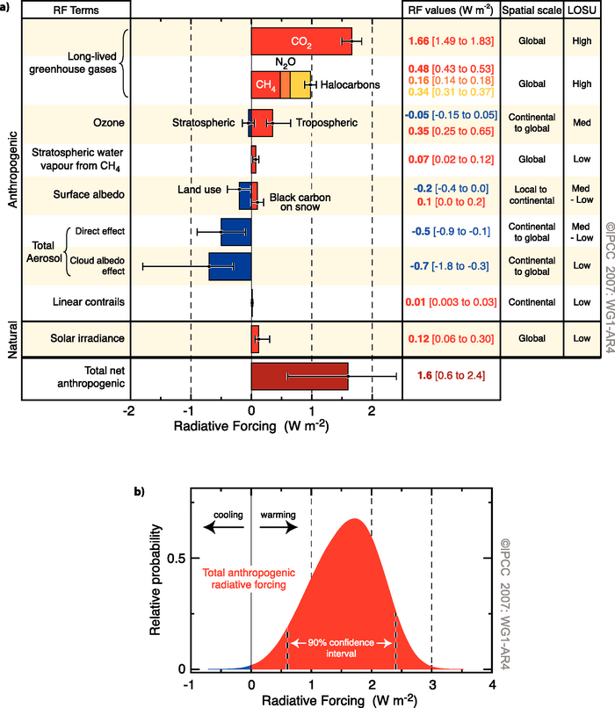
Radiative forcings
RF for different mechanisms
most significant anthropogenic positive RF term is CO2 followed by CH4, Tropospheric O3, Halocarbons, NO2, (natural) Solar irradiance variations, and black carbon effects on snow (lowering snow albedo).
Notes:
(a) Global mean radiative forcings (RF) and their 90% confidence intervals in 2005 for various agents and mechanisms. Columns on the right-hand side specify best estimates and confidence intervals (RF values); typical geographical extent of the forcing (Spatial scale); and level of scientific understanding (LOSU) indicating the scientific confidence level as explained in Section 2.9. Errors for CH4, N2O and halocarbons have been combined. The net anthropogenic radiative forcing and its range are also shown. Best estimates and uncertainty ranges can not be obtained by direct addition of individual terms due to the asymmetric uncertainty ranges for some factors; the values given here were obtained from a Monte Carlo technique as discussed in Section 2.9. Additional forcing factors not included here are considered to have a very low LOSU. Volcanic aerosols contribute an additional form of natural forcing but are not included due to their episodic nature. The range for linear contrails does not include other possible effects of aviation on cloudiness. (b) Probability distribution of the global mean combined radiative forcing from all anthropogenic agents shown in (a). The distribution is calculated by combining the best estimates and uncertainties of each component. The spread in the distribution is increased significantly by the negative forcing terms, which have larger uncertainties than the positive terms. {2.9.1, 2.9.2; Figure 2.20}

Slide 15
Carbon in the Earth System
4th most abundant element in the universe.
able to bond with itself and many other elements
forms over 10 million known compounds.
present
in the atmosphere as CO2, CH4 etc)
in all natural waters as dissolved CO2
in various carbonates in rocks
as organic molecules in living and dead organisms in the biosphere .

Slide 16
Carbon in the Earth System
also important in radiative forcing
Directly
Halocarbons in the atmosphere
black carbon deposits on snow
indirectly
elsewhere (e.g. land cover change).

Slide 17
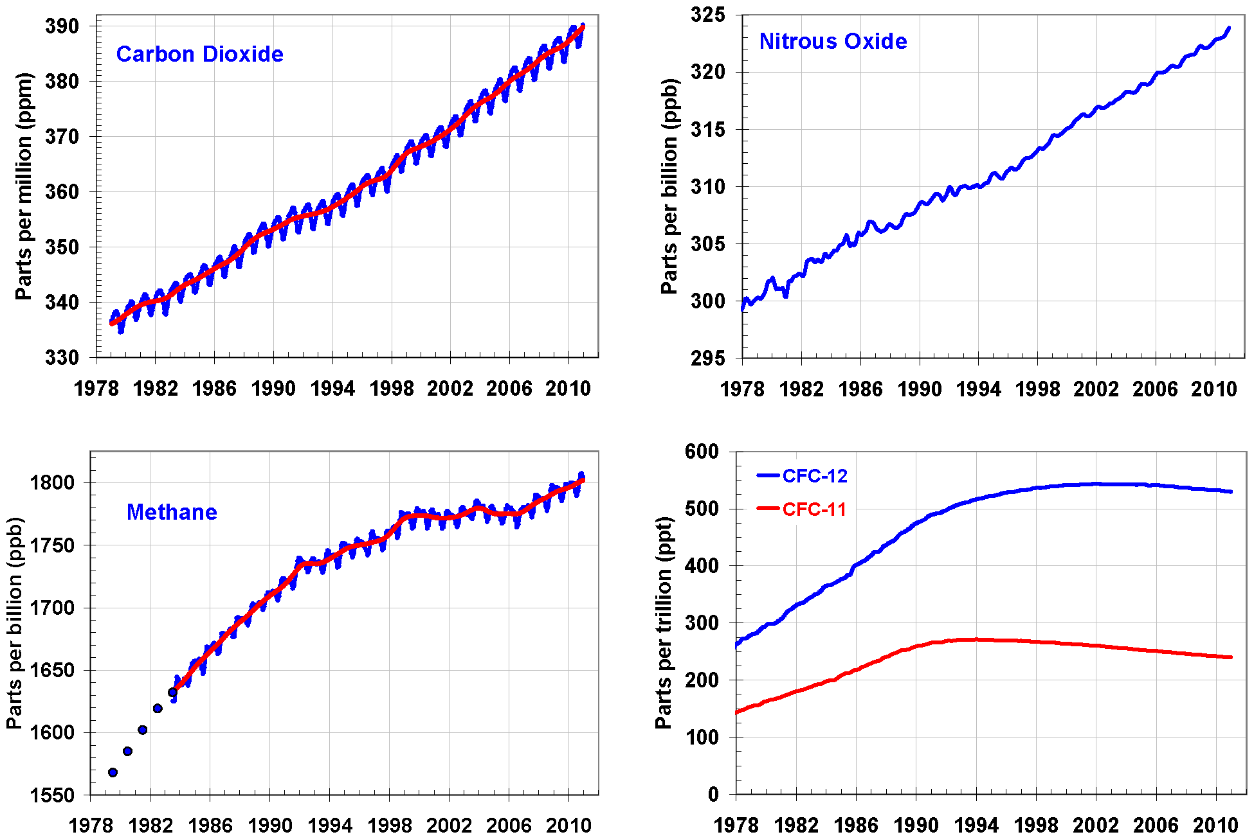
Atmospheric Carbon and Greenhouse Gases
Notes:
Global average abundances of the major, well-mixed, long-lived greenhouse gases - carbon dioxide, methane, nitrous oxide, CFC-12 and CFC-11 - from the NOAA global air sampling network are plotted since the beginning of 1979. These gases account for about 96% of the direct radiative forcing by long-lived greenhouse gases since 1750. The remaining 4% is contributed by an assortment of 15 minor halogenated gases (see text). Methane data before 1983 are annual averages from Etheridge et al. (1998), adjusted to the NOAA calibration scale [Dlugokencky et al., 2005].

Slide 18
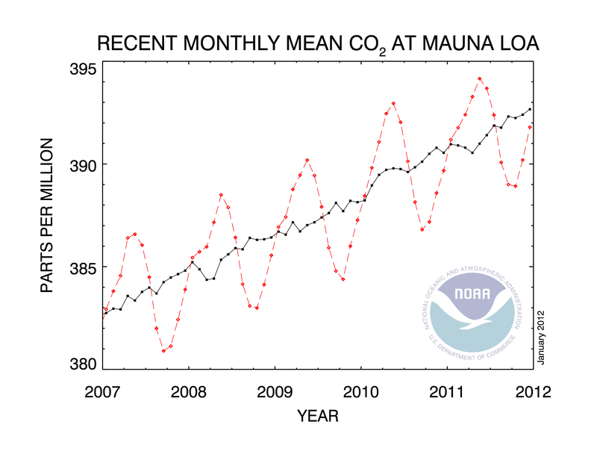
Annual cycles

Slide 19
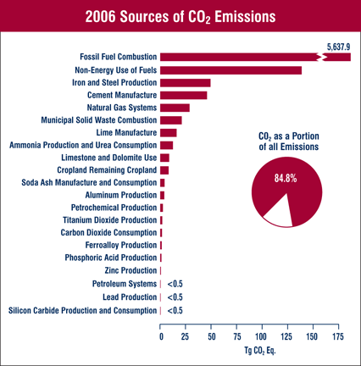
US emissions (2006)
Notes:
Fossil fuel bar far largest

Slide 20
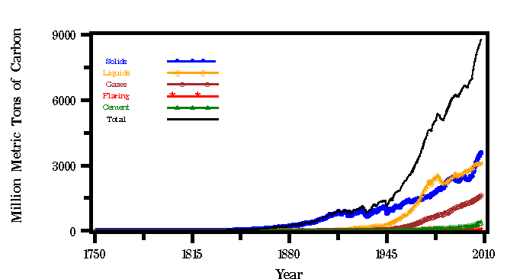
Global trends

Slide 21
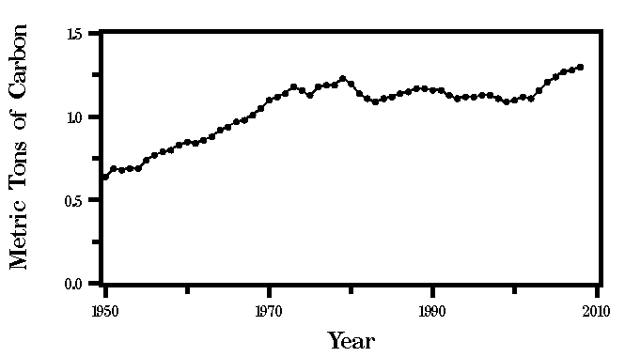
EXERCISE
Data on CO2 emissions and per capita emissions
Global per capita emissions

Slide 22
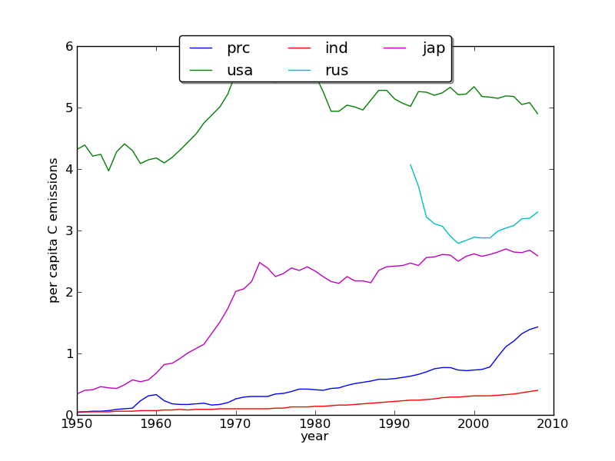
EXERCISE
Notes:
Per capita emissions top 5 countries

Slide 23
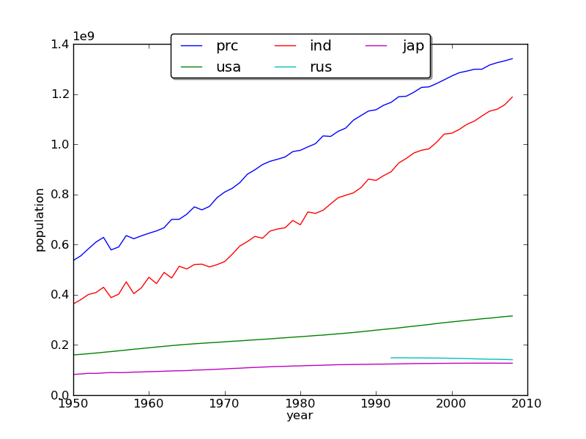
EXERCISE
Notes:
Population top 5 countires

Slide 24
EXERCISE
Identify those countries in the top twenty emitting nations lists which have increasing trends in (a) population and (b) per capita emissions rates. Rank them in order.

Slide 25
EXERCISE
Given a start at some code …
The code above provides linear extrapolation estimates for per captia emissions for the year 2020 based on data for 1995 to 2008.
Adapt the code so that it provides estimates of Total Fossil-Fuel Emissions for 2020 for the top 20 emitting countries, assuming population does not increase.
Adapt the code so that it provides estimates of Total Fossil-Fuel Emissions for 2020 for the top 20 emitting countries, assuming a linear trend in population.
Use these two sets of figures to estimate the impact of population growth on total (global) Fossil-Fuel Emissions for 2020 (i.e. what proiortion of the change in estimated emissions can be attributed to population growth?). You can assume that the proportion of emissions from the top 20 countries remains at 63% if you need that information.
What impact does the time period over which you perform the linear regression have (e.g. change it to start at 2000)?
If you have time, you might try to estimate the uncertainty on these estimates.
Criticise the model developed. What factors might come into play that we have not accounted for here (a starter: global economic conditions; also, have we missed any important countries)?

Slide 26
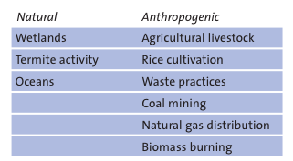
Methane

Slide 27
NO2
Anthropogenic activity accounts for around 30% of N2O, with tropical soils and oceanic release account for the majority of the remainder

Slide 28
halocarbons
Refrigerants, aerosols …
Limited by “Montreal Protocol on substances that deplete the Ozone Layer”
Despite control, their continued presence in the atmosphere is of continuing concern for Ozone depletion as well as their role as GHGs.

Slide 29
Terrestrial Carbon
carbon that is stored in the vegetation and soils of the Earth’s land surface
The Earth Systems Science:
Maintain focus on interactions between different spheres, but understand processes and interactions within each sphere.

Slide 30
Terrestrial Carbon
Justification:
major role it plays in anthropogenic climate change.
Also:
the role that terrestrial vegetation plays in biodiversity;
role of vegetation in providing food and fuel.

Slide 31
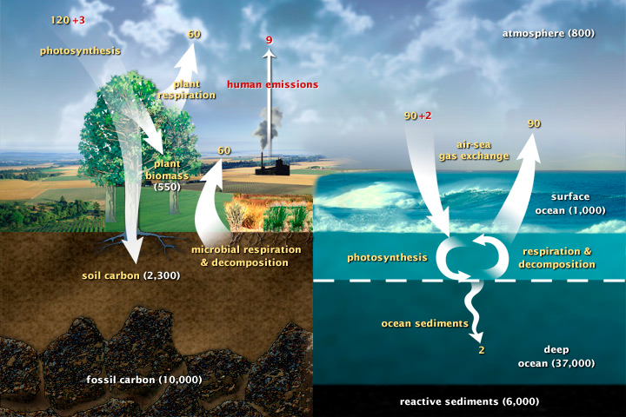
The Carbon Cycle
Notes:
This diagram of the fast carbon cycle shows the movement of carbon between land, atmosphere, and oceans. Yellow numbers are natural fluxes, and red are human contributions in gigatons of carbon per year. White numbers indicate stored carbon

Slide 32
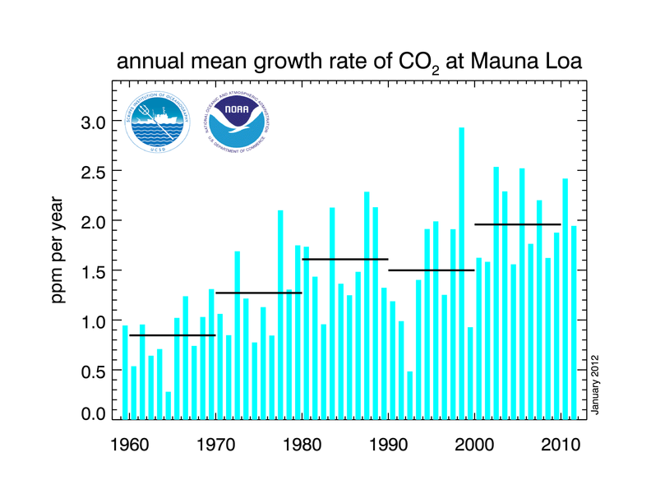
CO2 growth rate
Notes:
The annual mean growth rate of CO2 in the atmosphere is around 2 ppmv of CO2, from which it can be inferred that just over 2 ppmv of CO2 must enter other fast pools of carbon.

Slide 33
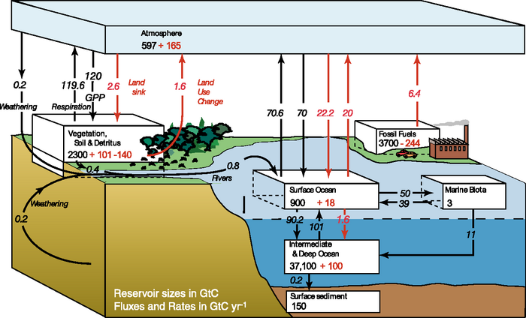
Carbon Cycle
Notes:
The figures given by the IPCC in AR4 are 4.1 +/- 0.1 GtC y-1 annual mean CO2 growth rate for the period 2000 to 2005 with annual emissions from fossil fuel burning and cement production at 7.2 +/- 0.3 GtC y-1 for that same period. The sink to the ocean carbon pool is estimated as 2.2 +/- 0.5 GtC y-1 and that to the land pool as 0.9 +/- 0.6 GtC y-1 (0.9 + 2.2 + 4.1 = 7.2).
For example, the land sink of around 0.9 +/- 0.6 GtCy-1 is itself composed of a balance between a primary production land sink and a land use change source.

Slide 34
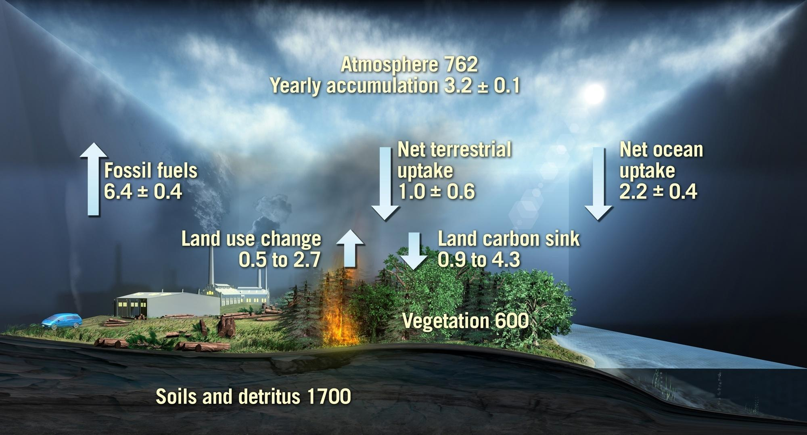
The global carbon cycle for the 1990s
Values from IPCC 2007. Units: Gigatons of carbon/ yr
Notes:
Values from IPCC 2007 – average for 90s
FF
Atmos increase
Balance made up by net flows to ocean and land
Important to note that the net flux to the land has 2 components
Anthropogenic source (LUC – not just fire)
Sink term, some of which is die to forest growth
Also shown on slide are C pools
600 Gtc in veg biomass, comparable to atmos
Soils poll, 3 times larger , but less mobile on annual to decadal t-scales
BIOMASS addresses the veg. carbon pools and fluxes associated with forests
Link: I now want to focus on the uncertainties in the fluxes

Slide 35

The mean global carbon cycle for the 1990s
9
8
7
6
5
4
3
2
1
Residual land sink
High
High
Residual land sink
Land use change flux
Land use change flux
Low
Low
Fossil fuel emissions
Net ocean
sink
GtC/year
Atmospheric increase
AnthropogenicSources
Changes in C pools
User Consultation Meeting, Lisbon, Portugal, 20-21 January 2009 biomass
Notes:
Good measurements and error estimates. Note error bars – ~20% for ocean.
Anthropogenic sources not complete – need LUC (mainly trop deforestation)
In IPCC, no error bars on this estimate, just a range, from low to high
Here’s low; for the budget to balance this implies a sink term as shown.
Here’s the high, and the corresponding sink term
If we think of the LUC range as uncertainty, it is about 70% - much greater than for the ocean flux. It dominates the error budget .
The sink term is a residual, just to make things balance. Since we have little idea of its actual magnitude, explaining it is fraught with uncertainty. Certainly uptake into biomass is part of this term
Will talk about biomass in context of 2 top boxes; the left is a decrease in biomass, part of the right is forest growth.

Slide 36
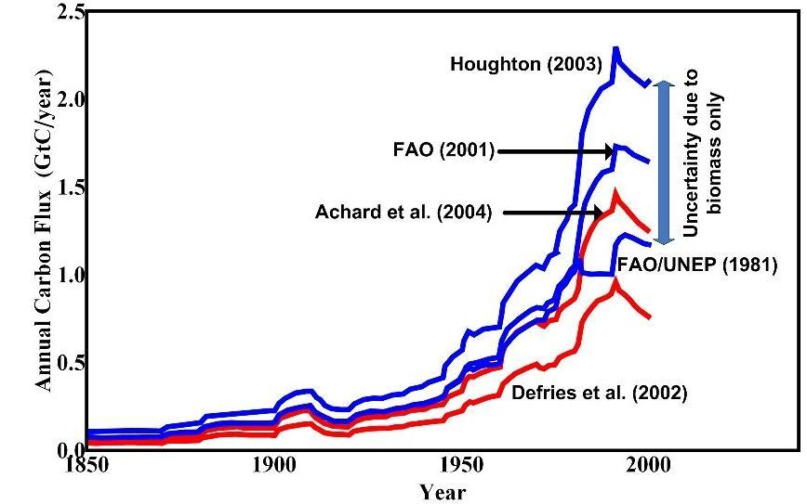
Uncertainty in carbon emissions due to biomass
Humid Tropical
Deforestation
Notes:
Uncertainty of 1 GtC pa due entirely to uncertainty in mean biomass
Also, note that these calculations take no account of the possibility that deforestaion may preferentially take areas of high or low biomass
To do this properly, we need
Maps of biomass to know what has actually been deforestsed
Scale of maps need to be comparable with the deforestation process – around 100 m
Check values of area deforested

Slide 37
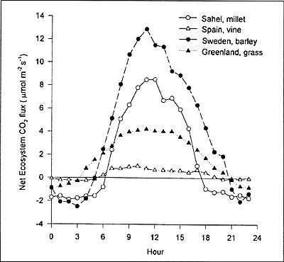
Biogeochemical processes
Net Ecosystem CO2 flux: NEP
Diurnal variations
Notes:
Explain .. Daytime flux positive, nighttime negative … GPP photosynthesis & (autotrophic) respiration

Slide 38
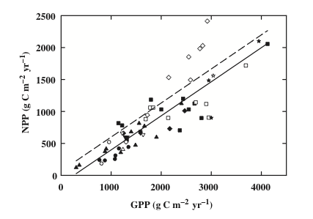
NPP/GPP: CUE
Notes:
Assumed approx 0.5 but can vary significantly
CUE is C use efficiency

Slide 39
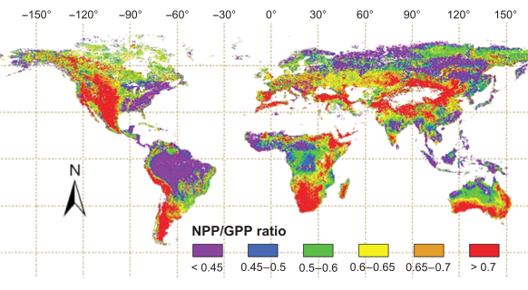
NPP/GPP
Notes:
Zhang et al GCB 2009

Slide 40
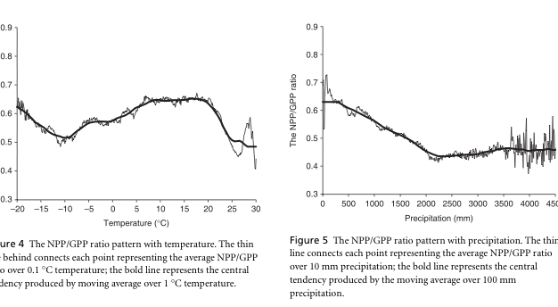
CUE dependencies
Notes:
Zhang et al. GCB 2009
Strong precip dependence, also T, altitude … discuss

Slide 41
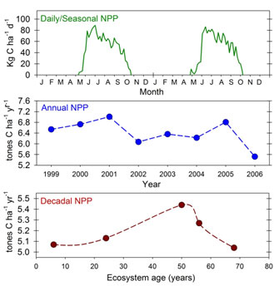
NPP temporal scales
Notes:
dicsuss

Slide 42
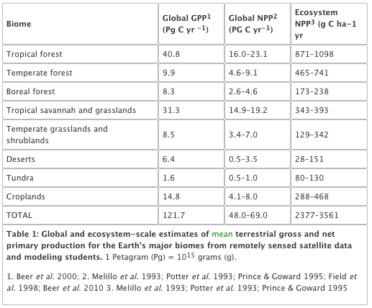
NPP biomes
Notes:
Gough, C. M. (2011) Terrestrial Primary Production: Fuel for Life. Nature Education Knowledge 2(2):1
Nice website …

Slide 43
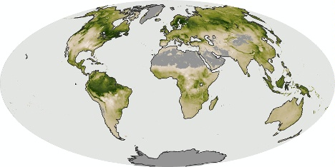
NPP: July 2006

Slide 44
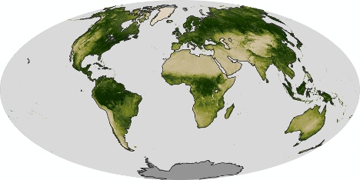
NDVI: July 2006

Slide 45
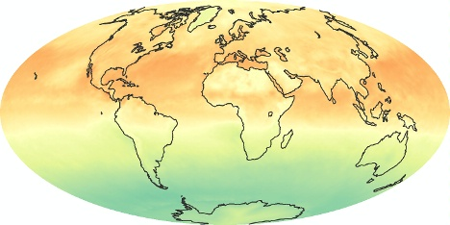
Net radiation: July 2006

Slide 46
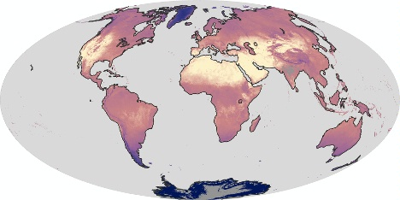
LST: July 2006

Slide 47
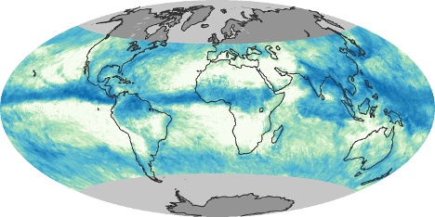
Precip: July 2006

Slide 48
NPP: July 2006

Slide 49
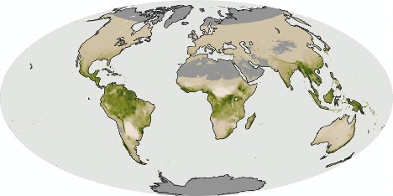
NPP: Dec 2006

Slide 50
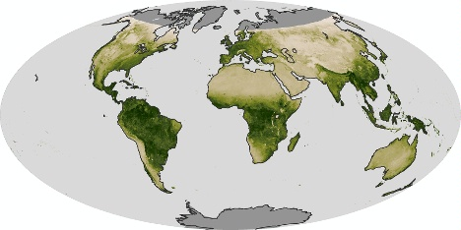
NDVI: Dec 2006

Slide 51
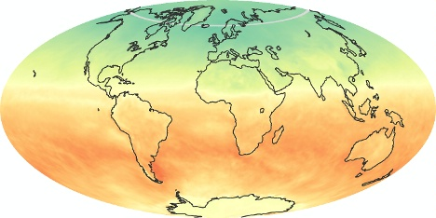
Net radiation: Dec 2006

Slide 52
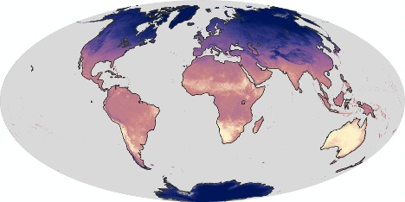
LST: Dec 2006

Slide 53
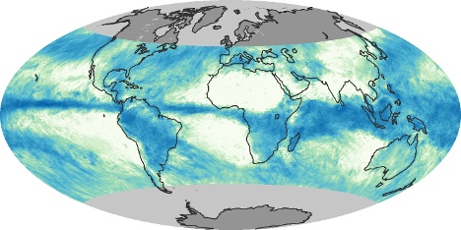
Precip: Dec 2006

Slide 54
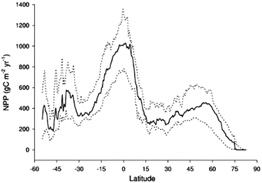
Latitudinal distribution of NPP

Slide 55
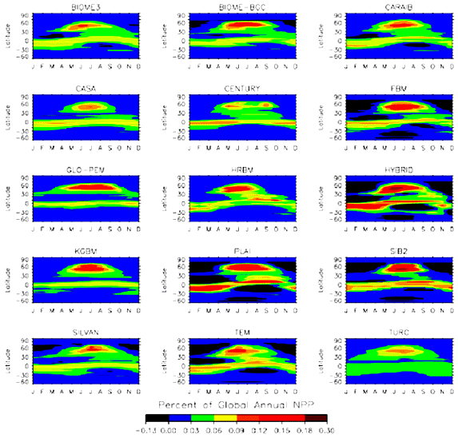
Latitudinal and time distribution NPP
Notes:
Since the total landmass (and in particular the vegetated landmass) in the Southern hemisphere is less than that of the Northern hemisphere, global NPP comes predominantly from Northern latitudes. Referring back to the plots of the annual cycle of atmospheric CO2 above, we noted a peak in May and a trough in October, largely then in response to global NPP increases in Spring and decreases in Autumn: the larger NPP in Northern hemisphere summer gradually decreases the atmospheric CO2 concentration. This is however complicated by the timing and spatial distribution of other CO2 sources and sinks.

Slide 56
Net Ecosystem Productivity
NEP = NPP minus other losses
respiration by heterotrophs (organisms – fungi, animals and bacteria in the soil),
other losses to the ecosystem such as through harvesting or fire.

Slide 57
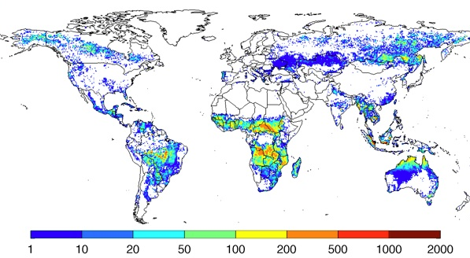
fire
Notes:
Annual carbon emissions (as g C m-2 year-1), averaged over 1997-2009. These emissions estimates are build combining burned area data from above with a biogeochemical model (CASA-GFED) that estimates fuel loads and combustion completeness for each monthly time step. These fuel loads are based on satellite derived information on vegetation characteristics and productivity to estimate carbon input, and carbon outputs through heterotrophic respiration, herbivory, and fires

Slide 58
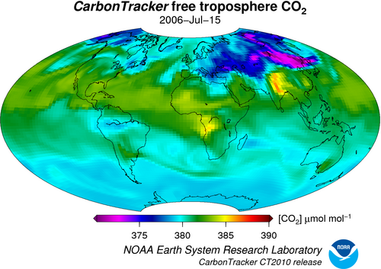
Atmos CO2
Notes:
Quite small range really (well-mixed) + rather different to NPP distributions … discuss??

Slide 59
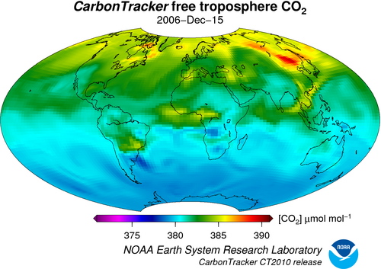
Atmos CO2

Slide 60
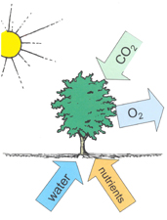
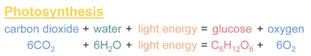
Photosynthesis
Notes:
In essence, what it does is to split (proportionately) 12 water molecules (H20) and produce 6 molecules of oxygen gas (O2) and 6 of H20. Carbon dioxide is reduced to glucose (C6H12O6) which is the basic material from which other biochemical constituents of biomass are synthesised (Grace, 2001). Note that the additional 6H2O are omitted in the figure above which does not include transpiration.

Slide 61
Transpiration
Provides 10% of moisture found in atmosphere.
uses around 90% of water that enters plant
(the rest being used in cell growth and photosynthesis).
Most transpiration water in stomata of the leaves.
guard cells of the stomata open to allow CO2 diffusion from the air for photosynthesis.
can be thought of as the “cost” for opening stomata to allow the diffusion of carbon dioxide gas from the air.

Slide 62
Stomatal conductance
Stomatal conductance, (e.g. in mmol m-2 s-2)
measure of the rate of passage of carbon dioxide (CO2) exiting, or water vapor entering through the stomata of a leaf.
controlled by guard cells leaf stomata and controls transpiration rates and CO2 diffusion rates (along with gradients of water vapour and CO2).

Slide 63
Transpiration serves three main roles:
movement of minerals
(from roots: xylem) and sugars (from photosynthesis: phloem) throughout the plant.
cooling
(loss of heat energy through transpiration)
maintenance of turgor pressure
in plant cells for plant structure and the functioning of guard cells in the stomata to regulate water loss and CO2 uptake.

Slide 64
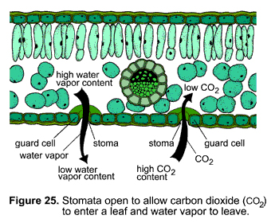
stomata

Slide 65
three types of photosynthesis mechanisms
C3, C4, CAM
C3:
85% of plants
wheat, barley, potatoes and sugar beet and most trees.
cannot grow in hot climates because RuBisCO incorporates more oxygen into RuBP as temperatures increase
photorespiration and a net loss of carbon (and nitrogen) that can act as a limit to growth.
C3 plants are also sensitive to water availability.

Slide 66
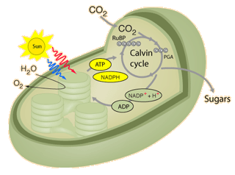
C3 plants use the Calvin cycle for fixing CO2.
Notes:
In the first step of the cycle CO2 reacts with RuBP to produce two 3-carbon molecules of 3-phosphoglyceric acid (3-PGA). This is the origin of the designation C3 or C3 in the literature for the cycle and for the plants that use this cycle. The entire process, from light energy capture to sugar production occurs within the chloroplast. The light energy is captured by the non-cyclic electron transport process which uses the thylakoid membranes for the required electron transport.

Slide 67
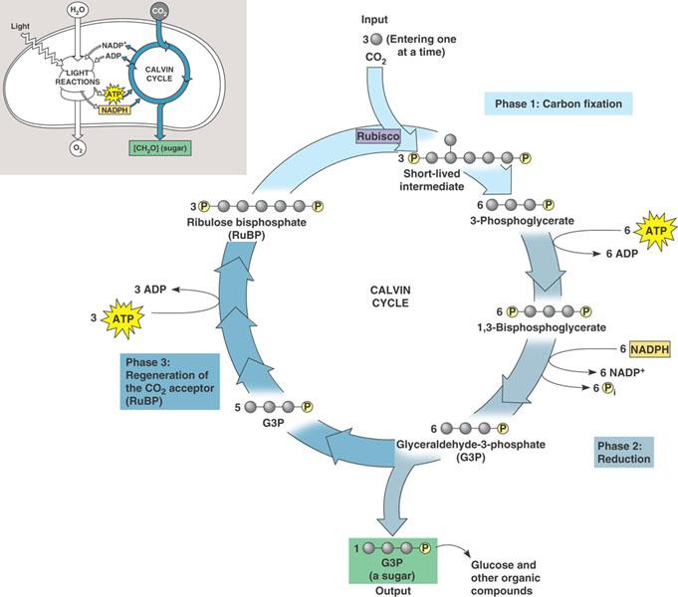
C3 plants use the Calvin cycle for fixing CO2.
http://bioap.wikispaces.com
Notes:
In the first step of the cycle CO2 reacts with RuBP to produce two 3-carbon molecules of 3-phosphoglyceric acid (3-PGA). This is the origin of the designation C3 or C3 in the literature for the cycle and for the plants that use this cycle. The entire process, from light energy capture to sugar production occurs within the chloroplast. The light energy is captured by the non-cyclic electron transport process which uses the thylakoid membranes for the required electron transport.

Slide 68
C4 Plants
C4 plants (and CAM plants)
more efficient than C3 plants under conditions of drought, high temperatures, and nitrogen or CO2 limitation.
bypassing the photorespiration pathway and efficiently delivering CO2 to the RuBisCO enzyme

Slide 69
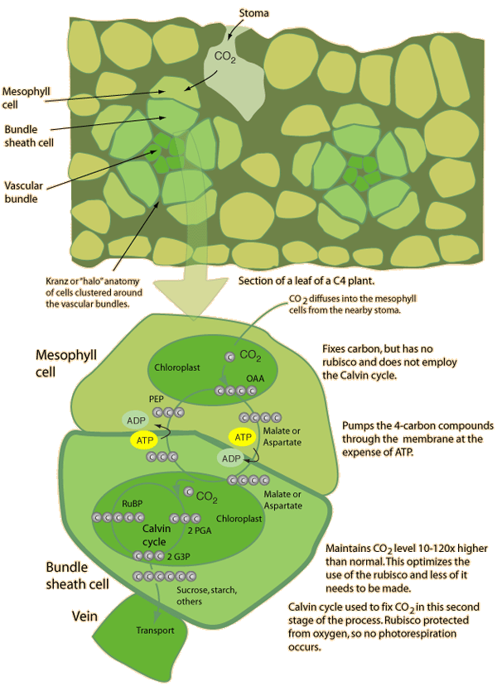
C4
Notes:
Different structure

Slide 70
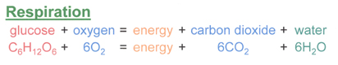
Respiration
(autotrophic) respiration
plants convert sugars back into CO2 and water, and release energy in the process.
energy released used for growth and maintenance of existing material.
Consumes 25% to75% of all of the carbohydrates generated in photosynthesis.

Slide 71
Limitations to photosynthesis at the leaf level
light limitation;
CO2 limitation;
nitrogen limitation and photosynthetic capacity;
water limitation;
temperature effects;
pollutants

Slide 72
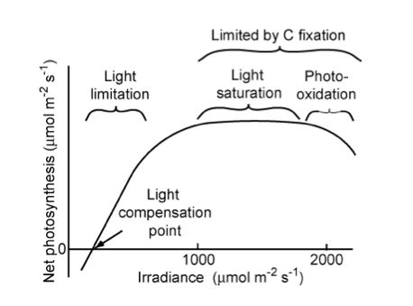
light limitation
Notes:
"Relationship of net photosynthetic rate to photosynthetically active radiation and the processes that limit photosynthesis at different irradiances. The linear increase in photosynthesis in response to increased light (in the range of light limitation) indicates relatively constant light use efficiency. The light compensation point is the minimum irradiance at which the leaf shows a net gain of carbon. " Source: Chapin, 2011, PTEEChap5.ppt, fig. 5.5

Slide 73
Light limitation
rate of change of net photosynthesis in low-moderate region: quantum yield of photosynthesis.
Similar for all C3 (non stress) at ~6%
Saturation at higher levels: reduced efficiency
Acclimation responses
Sun leaves
More cell layers and higher photosynthetic capacity
Respiration rate depends on tissue protein content
So shade leaves lower protein content to minimise respiration losses

Slide 74
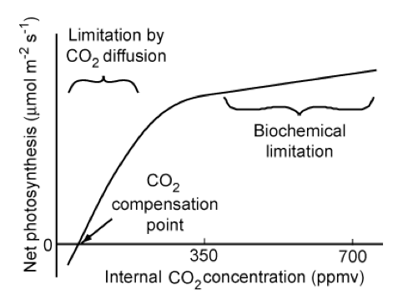
CO2 limitation
C3
Notes:
"Relationship of the net photosynthetic rate to the CO2 concentration inside the leaf. Photosynthetic rate is limited by the rate of CO2 diffusion into the chloroplast in the initial (left-hand side) linear portion of the CO2 response curve and by biochemical processes at higher CO2 concentrations. The CO2 compensation point is the minimum CO2 concentration at which the leaf shows a net gain of carbon. " Source: Chapin, 2011, PTEEChap5.ppt, fig. 5.10

Slide 75
CO2 limitation
Over long term, indirect effects of elevated CO2 concentrations may be more important than increased net photosynthesis rates
E.g. changes to water cycle
C4 relatively unresponsive
Less competitive in higher CO2 environment?
Probably indirect effects important

Slide 76
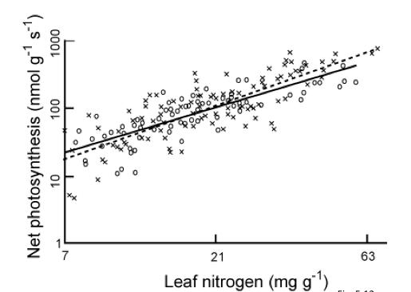
Nitrogen limitation and photosynthetic capacity
Notes:
"Relationship between leaf nitrogen concentration and maximum photosynthetic capacity (photosynthetic rate measured under favorable conditions) for plants from Earth's major biomes. Circles and the solid regression line are for 11 species from six biomes using a common methodology. Crosses and the dashed regression line are data from the literature. Redrawn from Reich et al. (1997)." Source: Chapin, 2011, PTEEChap5.ppt, fig. 5.11

Slide 77
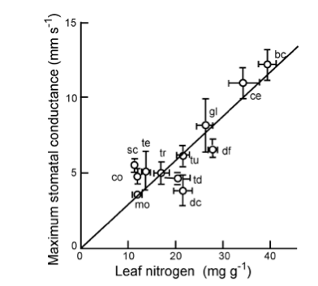
Nitrogen
Notes:
"Relationship between leaf nitrogen concentration and maximum stomatal conductance of plants from Earth's major biomes. Each point and its standard error represent a different biome: bc, broad-leafed crops; ce, cereal crops; co, evergreen conifer forest; dc, deciduous conifer forest; df, tropical dry forest; gl, grassland; mo, monsoonal forest; sc, sclerophyllous shrub; sd, dry savanna; sw, wet savanna; tc, tropical tree crop; td, temperate deciduous broadleaved forest; te, temperate evergreen broadleaved forest; tr, tropical wet forest; tu, herbaceous tundra. Redrawn from Schulze et al. (1994)." Source: Chapin, 2011, PTEEChap5.ppt, fig. 5.12

Slide 78

Nitrogen
Relationships between N, leaf lifespan, SLA and net photosynthesis
higher the leaf N concentration, the shorter the leaf lifespan.
Leaves with shorter lifspans tend to have lower specific leaf area (SLA, the leaf surface area per unit of biomass) (i.e. long-lived leaves are more dense), so higher leaf N concentration correlates with higher SLA.
Notes:
"The effect of leaf lifespan on photosynthetic capacity, leaf nitrogen concentration, and specific leaf area. Symbols as in Fig. 5.13. Redrawn from Reich et al. (1997)" Source: Chapin, 2011, PTEEChap5.ppt, fig. 5.13

Slide 79
Water limitation
reduces the capacity of leaves to match CO2 supply with light availability
manifested as a decrease in leaf relative water content (RWC).
Decreasing RWC progressively decreases stomatal conductance which slows CO2 assimilation (lower photosynthetic capacity) although different studies show different responses for RWC between 100% and 70%

Slide 80

Water limitation
Notes:
Typical non dry condition adapted response

Slide 81
Water limitation
Plants acclimated and adapted to dry conditions
reduce photosynthetic capacity and leaf N concentrations
low stomatal conductance that conserves water
minimse leaf area (shedding or lower leaf production rates) to minimise water loss.
Some minimise radiation absorption by higher leaf reflectance more vertically-inclined (erectophile) leaves.

Slide 82

Temperature effects
Notes:
Adaptation for different species, but all have optimal operating range

Slide 83
summary
considered the importance of understanding the science of climate change
looked at basic principles of energy transfer in the earth system
examined greenhouse gases and their sources
looked in detail at the terrestrial carbon cycle
provided an overview of relevant biogeochemical processes
looked in some detail at photosynthesis and factors that limit this

